Slide 1
Lecture 3
System Analysis
and Design

Slide 2
Chapter 2
_{The System Development}
_{Life Cycle}
Chapter 2
SP

Slide 3
Candidate Systems
A “Candidate System” is one which is approached after the analyst
has a thorough understanding of user needs and problems
has developed a viable solution to these problems, and then
communicates the solution(s) through the installation of such a system.
Chapter 2
SP

Slide 4
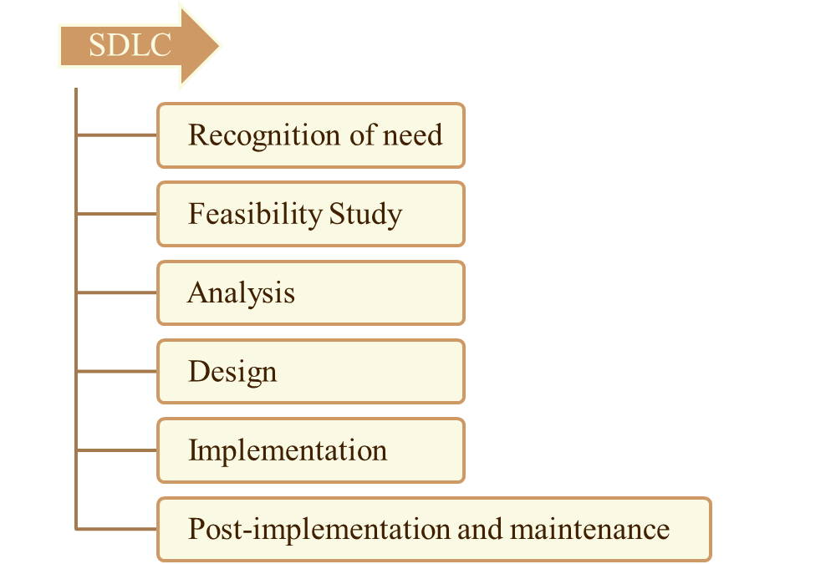
System Development Life Cycle
Chapter 2
SP

Slide 5
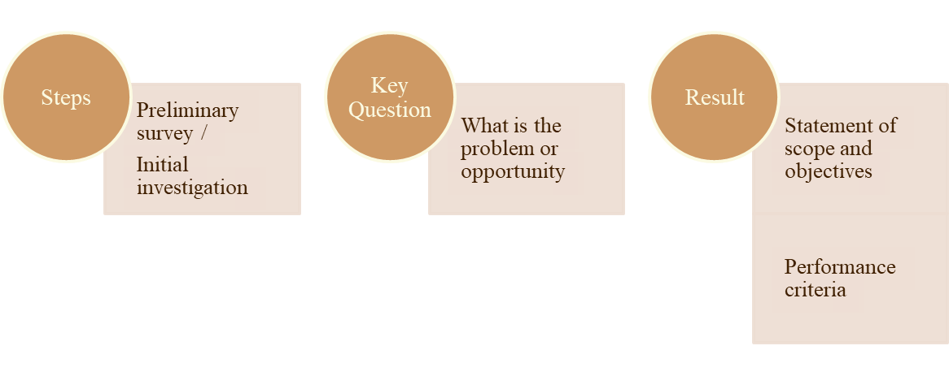
1. Recognition of Need
Chapter 2
SP

Slide 6
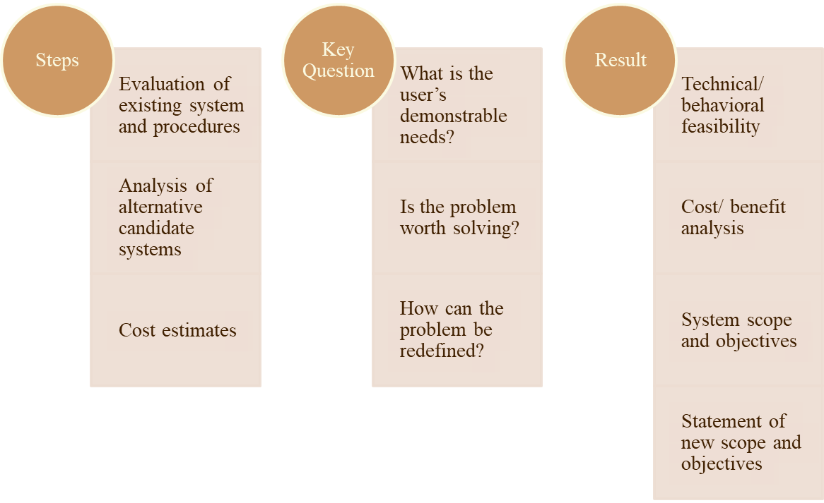
2. Feasibility Study
Chapter 2
SP

Slide 7
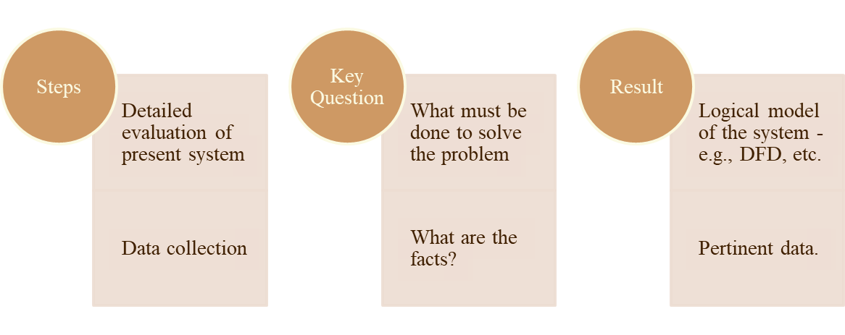
3. Analysis
Chapter 2
SP

Slide 8
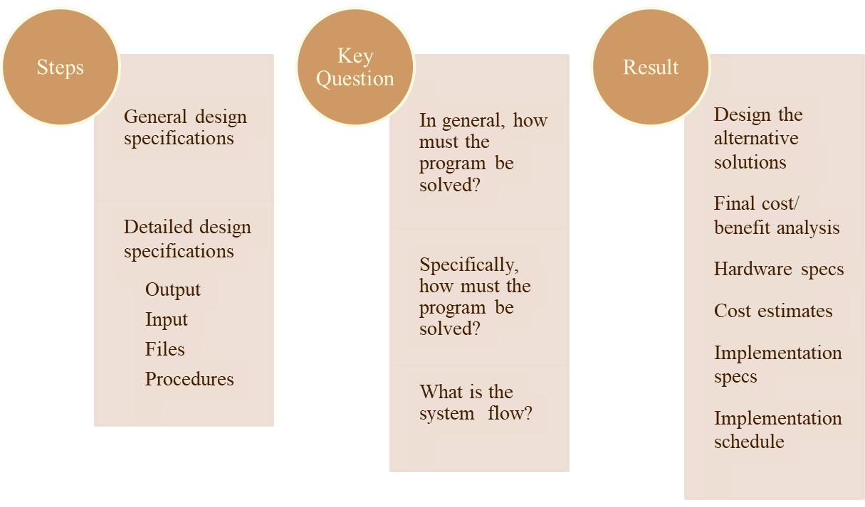
4. Design
Chapter 2
SP

Slide 9
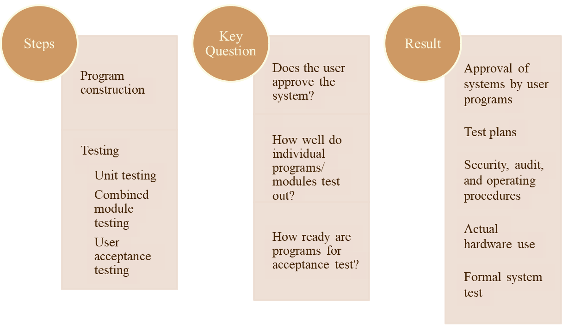
4. Design . .
Chapter 2
SP

Slide 10
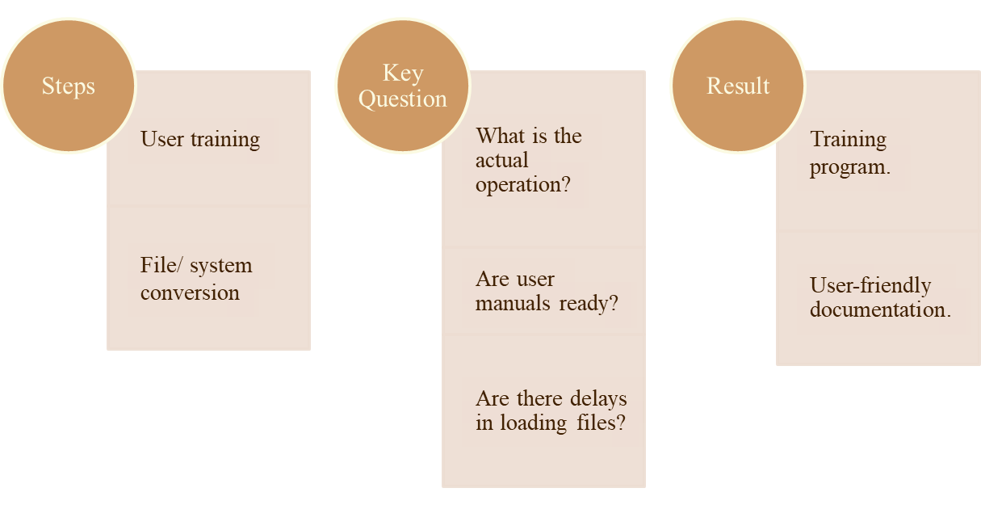
5. Implementation
Chapter 2
SP

Slide 11
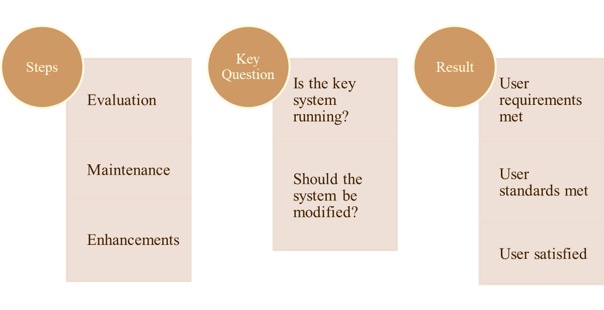
6. Post-implementation & maintenance
Chapter 2
SP

Slide 12
Impetus for system change
motivation/ prerona
The idea for probable change of a system originates:
In the environment
From within the firm
Environment-based ideas originate from
Customers, vendors, government sources, and the like.
For example:
New unemployment compensation regulations
Customer complaints about the delivery orders
Chapter 2
SP

Slide 13
Impetus for system change . .
Ideas may originate from within the organization
Top management, the user, the analyst
For example:
An organization acquires another organization
A local bank branches into suburbs
A dept spends 80% of its budget in 1 month
Two depts are doing essentially the same work
Chapter 2
SP

Slide 14
Impetus for system change . . .
These factors may also prompt top management to initiate an investigation:
Serious problems in operations
A high rate of labor turnover
Labor-intensive activities
High reject rates of finished goods
User-originated ideas also prompt initial investigations.
Chapter 2
SP

Slide 15
Factors crucial for a prompt response to a user request for a change
To what extent and how quickly a user-originated idea is converted to a feasibility study depend on:
The risks and potential returns
Management’s bias toward the user
Financial costs and the funds available for system work
Priorities of other projects in the firm
The persuasive ability of the user
Chapter 2
SP

Slide 16
Project termination
A system project may be dropped at any time prior to implementation:
Changing objectives or requirements of the user cannot be met by the existing design.
Benefits realized from the candidate system do not justify commitment to implementation.
There is a sudden change in the user’s budget
An increase in design costs beyond the estimate made during the feasibility study
The project greatly exceeds the time and cost schedule
Chapter 2
SP

Slide 17
Project failure
There are many reasons a new system does not meet user requirements:
User requirements were not clearly defined or understood.
The user was not directly involved in the crucial phases of the system development.
The analyst, programmer, or both were inexperienced.
The systems analyst (or the project team) had to do work within stringent time constraints.
Chapter 2
SP

Slide 18
Project failure . .
Existing hardware proved deficient to handle the new applications.
The new system left users in other departments out of touch with information that the old system had provided.
User training was poor.
The new system was not user-friendly.
Users changed their requirements.
The user staff was hostile.
Chapter 2
SP

Slide 19
Considerations for candidate systems
How much one project is favored over another depends on:
technical, behavioral, and economic factors.
Technical factor
It involves the system department’s ability to handle a project.
Much depends on the availability of qualified analysts, designers, and software specialists to do the work.
The alternative of abandoning a project because of limited talent on the inside is free-lancing it to an outside consulting firm.
Chapter 2
SP

Slide 20
Considerations for candidate systems . .
Behavioral factor
It involves
i) the user’s past experience with an existing system
ii) the success record of the analyst,
iii) the influence the user can exert on upper management to finance a candidate system
Political considerations, the status of the department, and its performance record are additional factors that bear on funding a candidate system.
Chapter 2
SP

Slide 21
Considerations for candidate systems . . .
Economic factor
It focuses on the system’s potential return on investment.
System consultants suggest an annual rate of return of just over 20%.
Political considerations
Political factor is partly behavioral.
Politics is the art of using influence and building coalitions when routine procedures do not achieve the high results.
Chapter 2
SP

